Slide 1



Summary article on COVID-19 virus status

Slide 2
On the morning of August 14, at the Government Headquarters, Deputy Prime Minister Vu Duc Dam, Head of the National Steering Committee for epidemic prevention and control, COVID-19 chaired the meeting to implement measures to prevent and control the epidemic in the current period. Information at the meeting, Acting Minister of Health Nguyen Thanh Long emphasized: The Ministry of Health has closely coordinated with the province to implement response measures; At the same time, the Ministry will also fully support Hai Duong province in tracing, quarantine, large-scale sampling, and rapid testing to prevent epidemics.

Slide 3

Acting Minister Nguyen Thanh Long: Provinces must raise the highest level of vigilance in the prevention of COVID-19 epidemic.

Slide 4
Although we are controlling the COVID-19 epidemic in Da Nang, Quang Nam, and some other localities, the Ministry of Health believes that the epidemic will continue to prolong and clusters of cases appear. and cases in the community, so localities have to raise their vigilance to the highest level for early detection and timely isolation, localization, epidemic control, and avoid the epidemic spreading to the community.

Slide 5
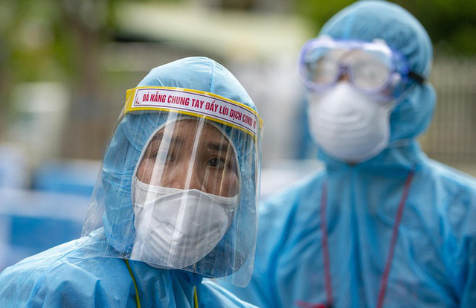

Slide 6
RECOMMENDATION.
According to the World Health Organization (WHO), just one wash of hands and clean hands reduces the likelihood of transmission of bacteria by 35%. Faced with the COVID-19 pandemic, the Ministry of Health also recommends frequent hand washing with soap/soap / quick hand sanitizer and clean water or alcohol-based hand sanitizer as a simple but effective preventative measure. fruit helps to limit the spread of disease.

Slide 7
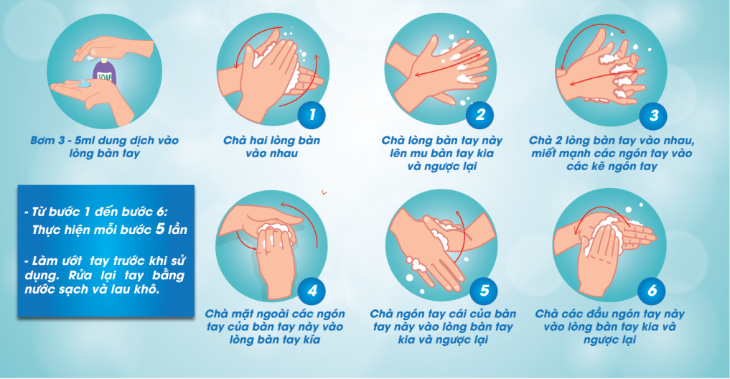

Slide 8
After returning from public places: Public places are always risky due to contact with many people, handling many common objects. Before and after eating: Bacteria can enter the body through inhalation or mouth, so it is necessary to wash hands properly before eating to avoid virus entering the body and after eating to keep hands. clean if handling or touching food. After going to the toilet: A toilet is a place containing a lot of pathogenic bacteria and a number of recent studies have warned that SARS-CoV-2 can be transmitted through the feces. Therefore, proper handwashing after using the toilet is essential.

Slide 9
Wear a mask when going to the street and in public, measuring the temperature before entering crowded places like (supermarkets, schools, ...)

Slide 10
The subject is susceptible to COVID -19 attack
People 65 years of age and older.
The elderly (NCT) are more susceptible to and die from COVID-19 because:
Immune function decreases with age, causing older persons to reduce their ability to fight against common infections.

Slide 11
Excessive inflammatory response: High levels of inflammation can damage the lungs and kidneys and affect many other organs in the body.
Ease of complications: Because older persons often have a pre-existing multidisciplinary condition, serious respiratory infections can complicate pre-existing heart, kidney, or liver disease.
Lung function decreases with age, so the ventilation is ineffective, if more pneumonia progresses, respiratory failure easily develops.

Slide 12
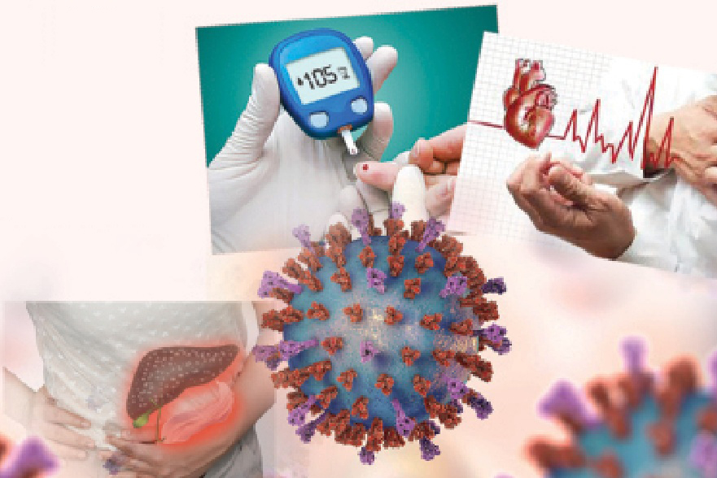

Slide 13
Chronic lung disease
People with chronic lung disease are considered to be at high risk for COVID-19. Respiratory conditions include Asthma, bronchiectasis, chronic obstructive pulmonary disease (COPD), pulmonary fibrosis and other interstitial lung diseases.

Slide 14
The risk may vary depending on the type of respiratory disease: COPD and interstitial lung disease are characterized by fibrosis and loss of lung elasticity, which will impair the patient's ability to breathe if COVID-19 is present; Asthma does not cause fibrosis, but COVID-19 infection can cause a serious and potentially life-threatening attack, especially in people with poor asthma control; Bronchiectasis causes excess mucus to build up. If pneumonia develops with COVID-19, airway obstruction can be life-threatening.

Slide 15


